Slide 1
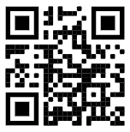
TopHat activities
Please join and indicate that you have done so:
https://app.tophat.com/login Join: 147651

Slide 2






Leicester Computer Science Society Presents
X
Details Here!
Join us for our 2023/2024 Hack Leicester. IBM mentors will be on deck, guiding you through challenges!
Saturday 10th Feburary
SIR BOB BURGESS BUILDING

Slide 3







Computer Science Society X Maths Society X Actuarial Science Society
CMS Spring Ball
YOU’RE
INVITED
For more details & tickets here
X
X
Step into glamour with a Red Carpet,
a three-course meal, dazzling photos, live big band, and exciting activities!

Slide 4
Join us for the evening!
EVENT DETAILS
MARK YOUR CALENDARS
DATE & TIME: Friday 1st March - 6.30pm until late
LOCATION: The Grand Hotel Leicester, Granby Pl, Leicester, LE1 6ES
WHAT TO WEAR
For more details & tickets here
THEME: The Oscars (Formal or Black Tie attire)
PRICES
SOCIETY MEMBERS - £26
NON-MEMBERS - £29.50
Includes a 3 course meal, live band + DJ and photographers

Slide 5

Non-Functional Requirements
CO1106 Requirements Engineering and Professional Practice
Dr Matthias Heintz
(mmh21@leicester.ac.uk)

Slide 6
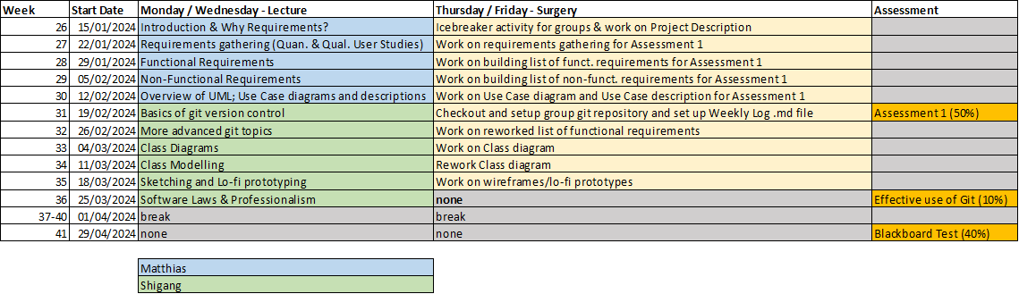
Schedule

Slide 7
Session objectives
At the end of the lecture you will:
Explain what non-functional requirements are
List four characteristics of a good written requirement
Identify problems with requirements and fix them

Slide 8
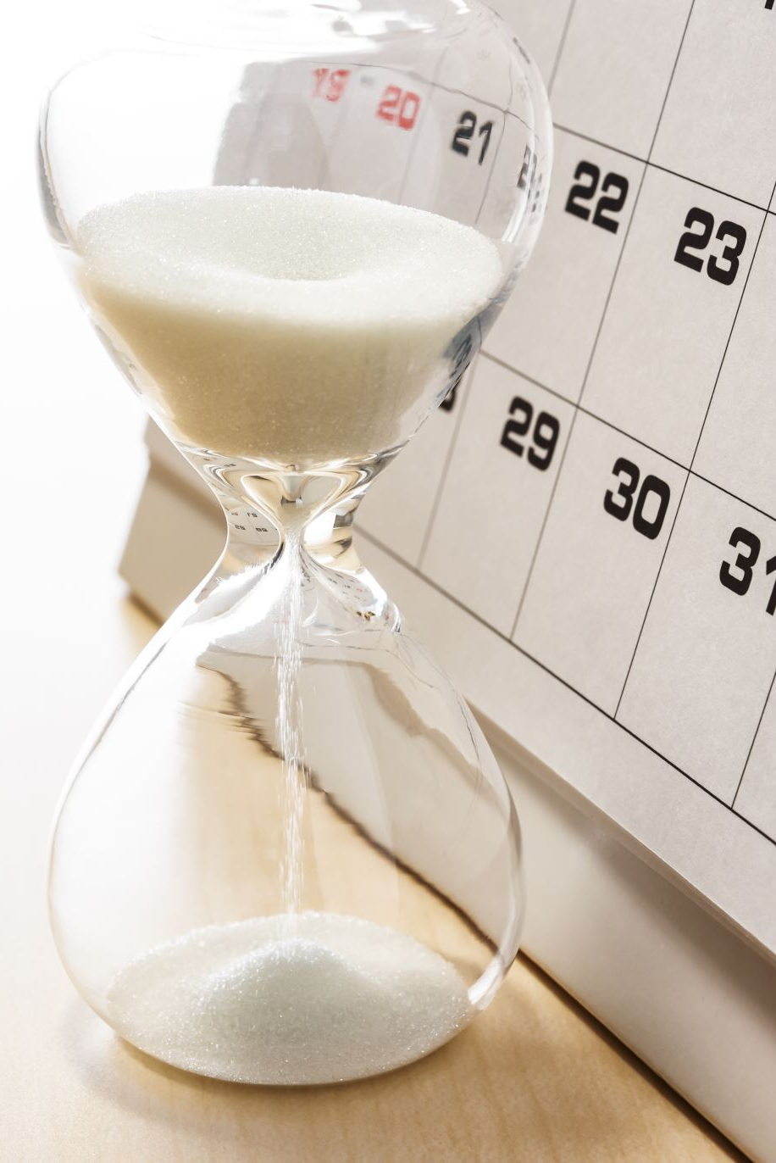
Group coursework in CO1106
Main group project
Part 1 (50% - due 23rd February)
Project description (10%)
Quantitative and qualitative studies (10%)
Written requirements (20%)
Use Case UML Diagram and Use Case Description (10%)
Part 2 (10% - due 27th March)
Effective usage of git version control

Slide 9
Group Coursework Part 1 - Task 3 Written requirements (20% of module marks)
Overview
You must produce between 1 and 2 pages of written requirements [functional (10%) and non-functional (10%) requirements] that describe, in detail, one or more of the key distinct features of your application (i.e. for example not the login process, but functionality that is specific for your project).

Slide 10
Instructions
Non-Functional requirements
Based on your project description and data collection / analysis results:
Think about which performance characteristics are needed (User Stories can help here)
Write must have / should have / could have non-functional requirements covering those characteristics
Focus on characteristics specific to your project (e.g. login speed, password reset time and other common characteristics are less important)
Notes:
Try to avoid group think, come up with 4 or 5 yourself, before taking them to the group

Slide 11
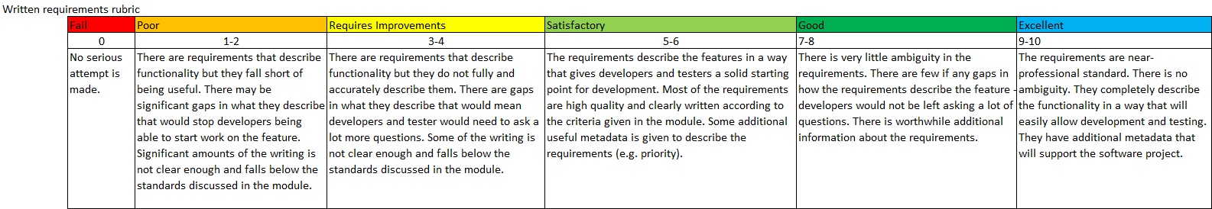
Marking rubric
Notes:
for completeness: Please read in your own time and ask any questions during the next lecture or during surgeries

Slide 12
Reminder: Functional and non-functional requirements
Functional requirements
Statements of services the system should provide, how the system should react to particular inputs and how the system should behave in particular situations.
May state what the system should not do.
Non-functional requirements
Constraints on the services or functions offered by the system such as timing constraints, constraints on the development process, standards, etc.
Often apply to the system as a whole rather than individual features or services.
Notes:
A functional requirement specifies something that a user needs to perform their work (e.g., visibility)
a system may be required to enter and print cost estimates
A non- functional requirement specify all the remaining requirements not covered by the functional requirements i.e., quality requirements
Accessibility, concurrency, performance efficiency, price, privacy, interoperability, usability, security, etc.

Slide 13
Non-Functional Requirements

Slide 14
Non-functional requirements
"How the system will do it": usually performance characteristics:
Speed - e.g. how long a page takes to load
Efficiency - e.g. how much memory it requires
Security
Capacity- e.g. how much data will the system hold
Accessibility - how easy it is to use
Non-functional requirements may be more critical than functional requirements. If these are not met, the system may be unusable.
Non-functional requirements should also be measurable
Notes:
These define system properties and constraints e.g. reliability, response time, and storage requirements. Constraints are I/O device capability, system representations, etc.
Process requirements may also be specified mandating a particular IDE, programming language or development method.

Slide 15

Non-functional requirements - Examples
“The login page will appear within 1 second”
“... not slow down for up to 100 simultaneous users.”
“Users should be able to log in without using a mouse.”
“The system can store 1000 images of 1GB each.”
“The system will initialise in less than 20 seconds.”

Slide 16
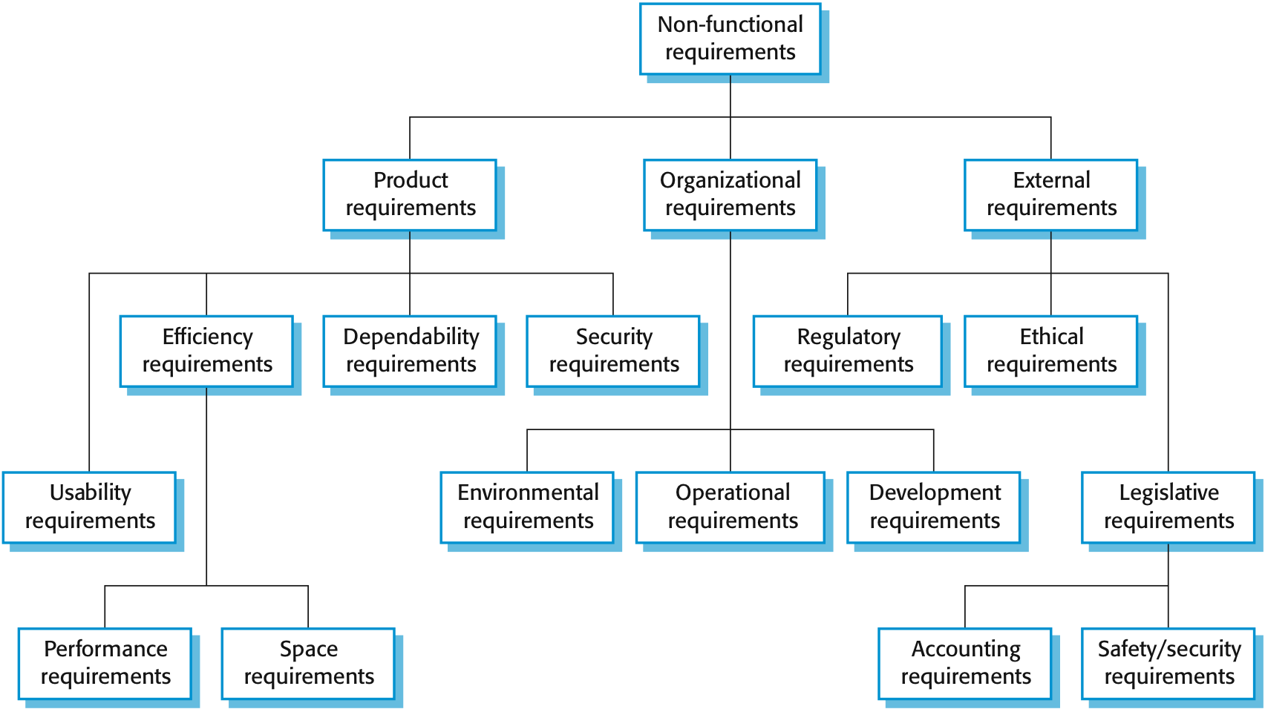
Types of nonfunctional requirement

Slide 17
Non-functional requirements implementation
Non-functional requirements may affect the overall architecture of a system rather than the individual components.
For example, to ensure that performance requirements are met, you may have to organize the system to minimize communications between components.
e.g.
“The password must be stored securely (hashed and salted) in the database.”
vs
“The https-protocol must be used for the entire system.”
A single non-functional requirement, such as a security requirement, may generate a number of related functional requirements that define system services that are required.
It may also generate requirements that restrict existing requirements.
Notes:
E.g. external services
Not indepenent

Slide 18
Metrics for specifying non-functional requirements
Property | Measure
Speed | Processed transactions/second User/event response time Screen refresh time
Size | Mbytes Number of ROM chips
Ease of use | Training time Number of help frames
Reliability | Mean time to failure Probability of unavailability Rate of failure occurrence Availability
Robustness | Time to restart after failure Percentage of events causing failure Probability of data corruption on failure
Portability | Percentage of target dependent statements Number of target systems
If possible, write them in a quantitative way
Notes:
e.g. training time – errors should be minimised

Slide 19
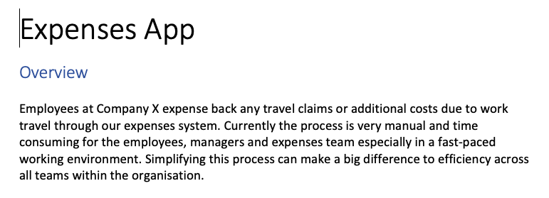
Reminder: User stories (expenses)

Slide 20
Reminder: User stories (expenses)
As an employee I want to login so that I can claim my expenses or see my previous claims
As a claimant I want to add a new expense claim so that I can be reimbursed for expenses
As a claimant I want to view a record of my previous expense claims so that I can check that I have been reimbursed correctly
As a claimant I want to return to partially completed expense claims so that I don’t have to complete the form in a single sitting

Slide 21
From User Story to Non-Functional Requirements
Think about
acceptance criteria for the user story
qualities the system needs to support this story

Slide 22
From User Stories (User Requirements) to Functional Requirements (System Requirements)
e.g.: “As a claimant I want to add a new expense claim so that I can be reimbursed for expenses.”
Can I save a draft of my claim and come back later to complete it?
Can I check the claim before submitting it?
Can I see the total claim amount based on what I have entered so far?
Can I add a claim at any time (24/7)?
=> “The system must have an uptime of 90% or more.”
Notes:
The last point is an example for a non-functional requirement.

Slide 23
Written System Requirements
Notes:
Most of the examples are functional requirements, but the concepts can be transferred to non-functional requirements as well

Slide 24
Written requirements
How to write a good requirement
(worth 10% of the module mark)

Slide 25
Good Written Requirements
Collectively - written requirements provide a COMPLETE description of the system.
Individually - a requirement provides very specific details about a small aspect of the system

Slide 26

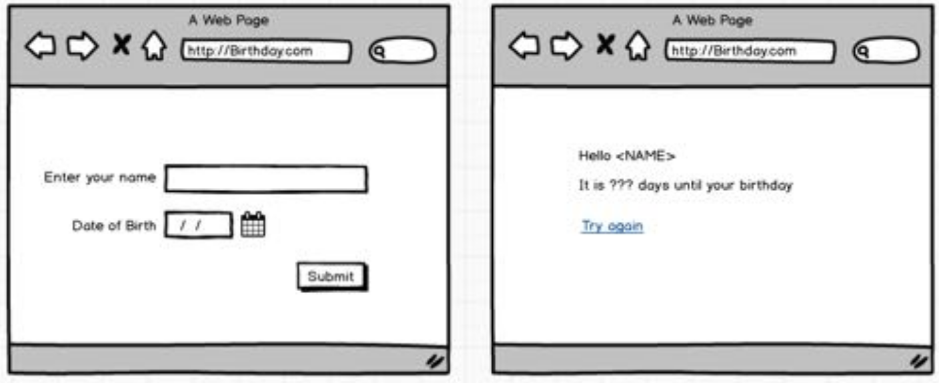
The birthday calculator

Slide 27

High-level description
"When a user enters and submits a valid date of birth, they are shown a message that includes their name, and the number of days until their next birthday."

Slide 28
To be complete we need to describe:
What is / is not allowed for a name
What is / is not allowed for a date of birth
What happens when they enter an invalid name/DOB
What text is displayed on the message screen
What message is given on their birthday
What happens when they click "try again"

Slide 29

To be complete we need to describe...
How quickly will the next page appear
Which web browsers will this work on
Will it accept unicode characters (or emojis)?
Probably a lot of other things we've not thought of....

Slide 30
Let's write some requirements for this…

Slide 31

Which is the best requirement?
The user can enter a name that mustn't be too long
The user can enter a name of up to 10,000 characters or 1000 words, whichever is longer
The user can enter a name of up to 200 characters
The user can enter a name of any length
The date must depend on the timezone in which the user is routed
Participate on TopHat:
https://app.tophat.com/login Join: 147651
Notes:
“too long” is not specific enough
Will any user have a name of 10000 characters or 1000 words length?
BEST: Clear and precise. See the following slides for detailed reasoning
system cannot deal with “any length”, e.g. unclear how much space to reserve for the name. Thus requirement needs to be reworked.
unclear which date: The birthday (doesn’t make sense), the date to calculate the number of days until their birthday? Should be clearly specified. Can we obtain the timezone of the user?

Slide 32
Qualities of Written Requirements

Slide 33
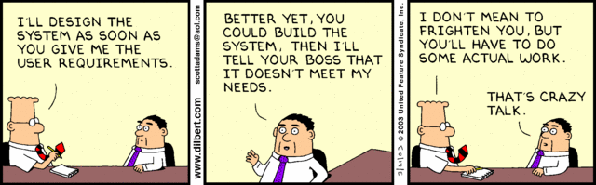
What makes a good written requirement?
https://app.tophat.com/login Join: 147651

Slide 34
What makes a good written requirement
Testable (or verifiable/unambiguous) (will we know when this has been done?)
Clear (or understandable)
Necessary (is this something people really need?)
Attainable (technically possible within time/budget)
(there are other things, e.g.
independent,
non-redundant,
implementation-free)
Notes:
Implementation-free(does not contain software design decisions)

Slide 35
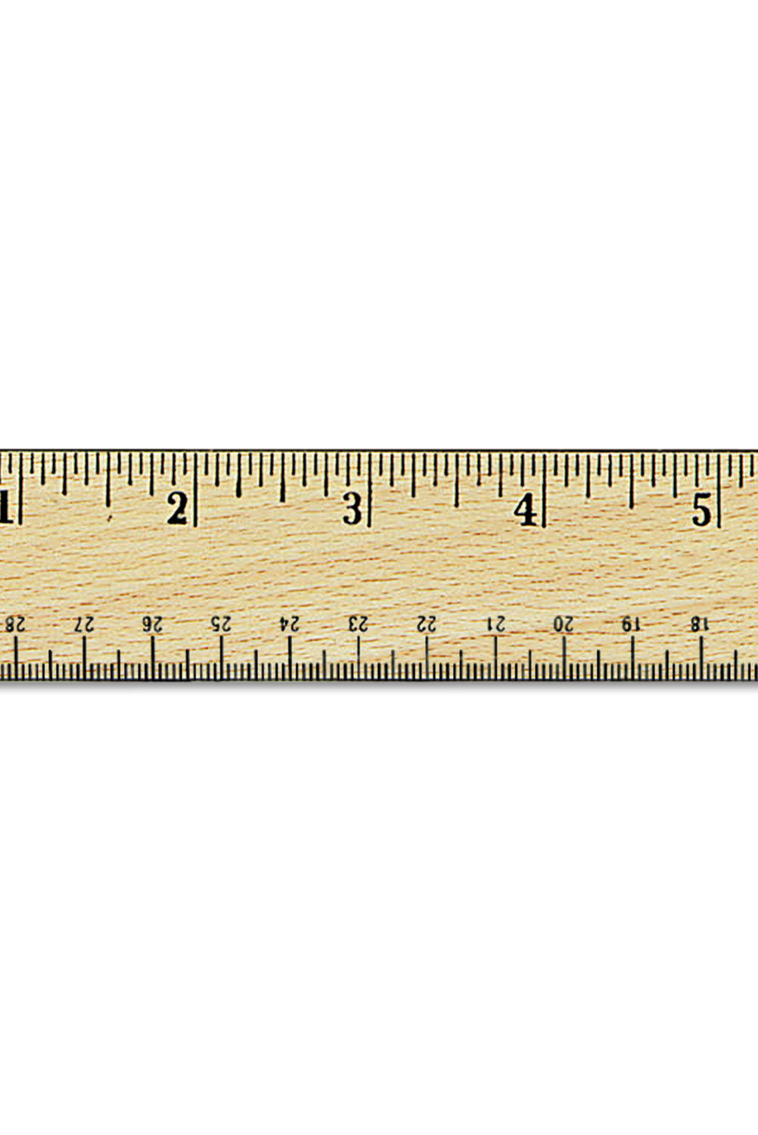
Good requirements are: testable (unambiguous)
Is the requirement written in a precise way that anyone can test and prove that the system fulfils it?
If it's vague or could have more than one interpretation, a developer will have to make a decision that may be different from what the customer/user expects.
“Each page should be shown quickly”
“Each page must appear within 3 seconds”
Notes:
How could the requirement “Each page should be shown quickly” be improved?

Slide 36
Which are testable? (unambiguous)
The user can enter a name that mustn't be too long
The user can enter a name of up to 10,000 characters of 1000 words, whichever is longer
The user can enter a name of up to 200 characters
The user can enter a name of any length
The date must depend on the timezone in which the user is routed

Slide 37
Which are testable? (unambiguous)
The user can enter a name that mustn't be too long
The user can enter a name of up to 10,000 characters of 1000 words, whichever is longer
The user can enter a name of up to 200 characters
The user can enter a name of any length
The date must depend on the timezone in which the user is routed

Slide 38

Good requirements are: clear (understandable)
Express a single thought, be concise, and simple
Avoid using complicated word, jargon or badly constructed sentences
"On the first page someone can enter any Indo-European name. It can contain any number of characters as long as there are less than 201”
"The user can enter a name of up to 200 characters”

Slide 39
Which are clear? (understandable)
The user can enter a name that mustn't be too long
The user can enter a name of up to 10,000 characters of 1000 words, whichever is longer
The user can enter a name of up to 200 characters
The user can enter a name of any length
The date must depend on the timezone in which the user is routed

Slide 40
Which are clear? (understandable)
The user can enter a name that mustn't be too long
The user can enter a name of up to 10,000 characters of 1000 words, whichever is longer
The user can enter a name of up to 200 characters
The user can enter a name of any length
The date must depend on the timezone in which the user is routed

Slide 41

Notes about clarity
It's hard to avoid jargon related to a system.
Use a glossary of definitions to help.
This is where models can really help.

Slide 42

Necessary
Is this something that the customers/users actually need?
Notes:
prioritise

Slide 43

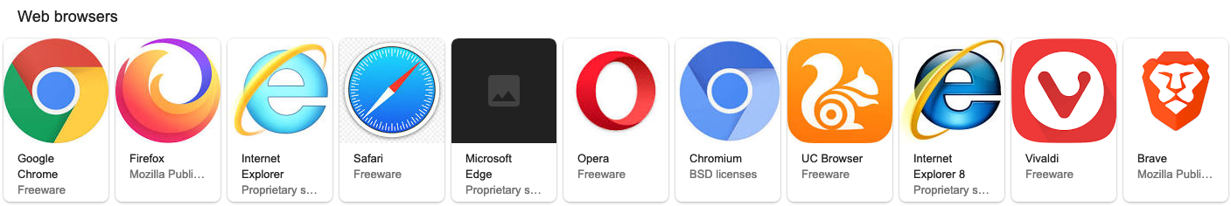
Necessary
Every requirement will cost money
Is this something they really want?
Or did one person think it's a "good idea”
Or worse, did the software team make it up?
If unsure, check with key customers / users
e.g. "The system must run in all web browsers"

Slide 44
Any of these not needed?
The user can enter a name that mustn't be too long
The user can enter a name of up to 10,000 characters of 1000 words, whichever is longer
The user can enter a name of up to 200 characters
The user can enter a name of any length
The date must depend on the timezone in which the user is routed

Slide 45
Any of these not needed?
The user can enter a name that mustn't be too long
The user can enter a name of up to 10,000 characters of 1000 words, whichever is longer
The user can enter a name of up to 200 characters
The user can enter a name of any length
The date must depend on the timezone in which the user is routed

Slide 46
Attainable / Realistic
Can the requirement be fulfilled within the timescales and budget of the project?

Slide 47
Attainable / Realistic
Unrealistic requirements will cause software projects to fail.
They are especially common in "non-functional" requirements
(e.g. speed, availability)
e.g.
"The system must be available 24 / 7 (100% of the time).”
"The system must log users out after 20 mins. But not if they are thinking about what to enter next."

Slide 48
Are these attainable?
The user can enter a name that mustn't be too long
The user can enter a name of up to 10,000 characters of 1000 words, whichever is longer
The user can enter a name of up to 200 characters
The user can enter a name of any length
The date must depend on the timezone in which the user is routed

Slide 49
Are these attainable?
The user can enter a name that mustn't be too long
The user can enter a name of up to 10,000 characters of 1000 words, whichever is longer
The user can enter a name of up to 200 characters
The user can enter a name of any length
The date must depend on the timezone in which the user is routed

Slide 50

Summary on writing requirements
Requirements need to be:
"Necessary”
"Testable”
"Attainable”
"Clear"
Which means they are usually: short, concise, specific, precise
Avoid vague words like "flexible", "normally", "reasonable", "good", "most", "easy", "etc", "user-friendly"

Slide 51
Exercise: Fix the Requirement

Slide 52
Exercise: Fix the requirement
The following requirement is poorly written. Split it up into multiple well-written requirements:
“The date of birth can be entered using a keyboard or mouse. If a keyboard is used then the date must be in the format 'dd-mm-yyyy'. If a mouse is used a calendar button can be clicked which displays a calendar to select a date which is then put into the text box in the format 'dd -mm-yyyy’.”
https://app.tophat.com/login Join: 147651

Slide 53
Exercise: Fix the requirement
Issues:
The requirement is way too long and thus hard to understand
The requirement combines different requirements into one
keyboard entry
mouse entry
format of date

Slide 54
Exercise: Fix the requirement
Example solution:
The key is to split up the ideas of entering using a keyboard and using a calendar with a mouse. The format can also be considered as a separate requirement:
The date of birth must be entered in the format 'dd-mm-yyyy’.
The date of birth can be entered by typing.
The user can open a calendar to select their date of birth.
Selecting a date using the calendar will show that date in the format 'dd-mm-yyyy’.

Slide 55

What’s next?
Rework your functional requirements based on the qualities of requirements discussed today (if needed).
Based on the results of your quantitative and / or qualitative user studies you should now generate non-functional requirements for your group project
Receive feedback on your progress during the surgeries
Lecture next week: Overview of UML; Use Case diagrams and descriptions

Slide 56
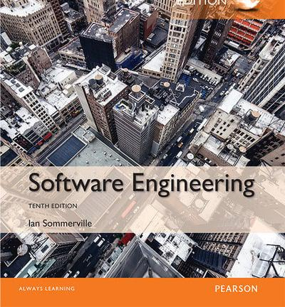
Additional reading
Ian Sommerville, Software Engineering
Chapter 4 Requirements Engineering

Slide 57

Questions?
Dr. Matthias Heintz
mmh21@leicester.ac.uk
Microsoft Teams
Office 613 in Ken Edwards Building

